Slide 1
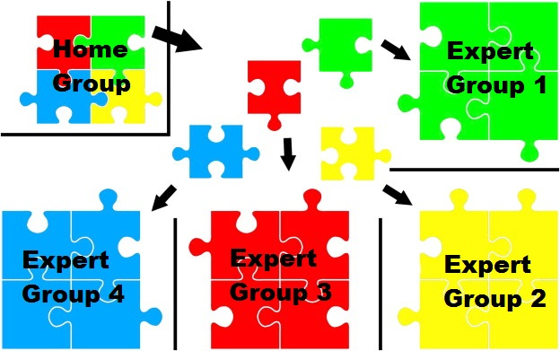
JIGSAW
( Teaching Technique)

Slide 2
Jigsaw Technique
A method of organizing classroom activity that makes students dependent on each other to succeed.
Breaks classes into heterogeneous groups.
Breaks assignments into pieces
The group assembles to complete the (jigsaw) puzzle.

Slide 3
Jigsaw
?

Slide 4
    FEATURES
    Collaborative and cooperative learning technique.
    Invented by Elliot Aronson (1970’s)
    Has multiple student groups.
    Sub divided/ segmented topics.
    Caters to all learning levels.
    Each student’s contribution essential.
    Hence, strategy effective.

Slide 5
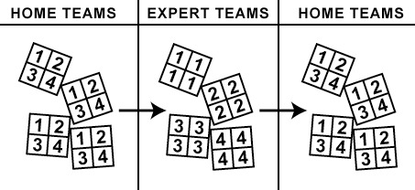
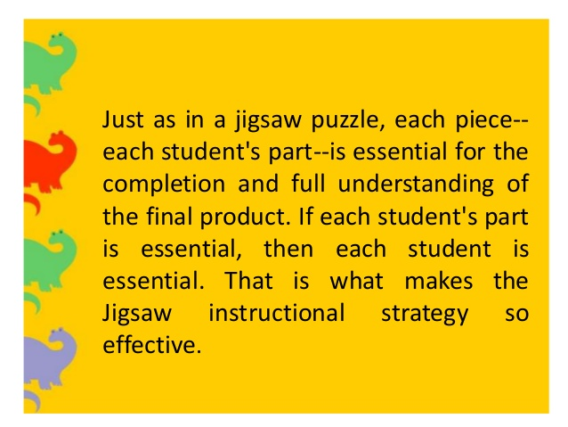

Slide 6
PURPOSE
Engagement:
Keeps the students constructively occupied.
Motivates and builds confidence.
Develops a high level of personal responsibility.
Increases sense of self worth.
Environment:
Creates less threatening environment.
Develops team work.
Helps in building in depth understanding of concept/ topic.

Slide 7
How To Do it…? In 10 Easy Steps
STEP ONE
Divide the class into four / five Jigsaw groups the class
Diverse in terms of gender, ethnicity, race, and ability.
STEP TWO
Apoint one student from each group as the leader.
Make a student leader of the group student leader
Should be the most mature student in the group.

Slide 8
STEP THREE
Divide the lesson into sub - topics s
STEP FOUR
Assign each student one sub topic to learn one
Make sure students have direct access only to their own segment.

Slide 9
STEP FIVE
Give time to read segment at least twice, become familiar with it.
No need for them to memorize it.
e and become familiar with it.
STEP SIX
Make expert groups - One student from each jigsaw group should join other students assigned the same segment. me segment.
Give students time to discuss the main points and to rehearse the presentations they will make to their jigsaw group.

Slide 10
STEP SEVEN
Bring the student back into their Jigsaw groups.
Bring the students back into their jigsaw
STEP EIGHT
Ask each student to present her or his segment to the group.
Encourage others in the group to ask questions for clarification.

Slide 11
STEP NINE
In case of disruptive behaviour – intervene in an appropriate manner.
Best for the group leader to handle this task, under guidance.
STEP TEN
At the end of the session, give a quiz on the material.

Slide 12
ROLE AND RESPONSIBILITY
TEACHERS:
ORGANISE:
Must structure the lesson – organise student groups.
Must define goals clearly.
OBSERVE:
Monitor group activity.
EVALUATE:
Conduct Quiz – have rubric to measure student performance.

Slide 13
ROLE AND RESPONSIBILITY
STUDENTS:
Research well.
Have self discipline.
Be self motivated.
Should be able to communicate effectively.

Slide 14
ADVANTAGES FOR STUDENTS:
Each student’s part is effective, hence each student is effective.
Heterogeneous Groups (Stronger Bonding)
Students gain practice in peer teaching
Promotes interpersonal skills (communication, leadership, decision making, conflict resolution etc.
Promotes listening skills, reading and comprehension skills, writing and presentation skills)
Empower, engage and motivate learners.
In-depth information and less time consuming.
Increased retention and better understanding.
Age appropriate teaching and learning

Slide 15
CHALLENGES
Time Consuming (requires planning, needs access to lot of material)
If planning not done properly - no assurance of content quality
Conflicts are bound to arise…. (dominating students )
Some may not take their responsibility seriously and let down the whole group

Slide 16
THANK YOU

